Slide 1
0x401 – Reverse Engineering
ECED4406 – Computer Security
Dr. Colin O’Flynn
Dalhousie University.

Slide 2

Forward Engineering?
Taking a problem, designing solution to that problem.
Understanding the underlying requirements.
Using well documented design documents (datasheets etc).

Slide 3
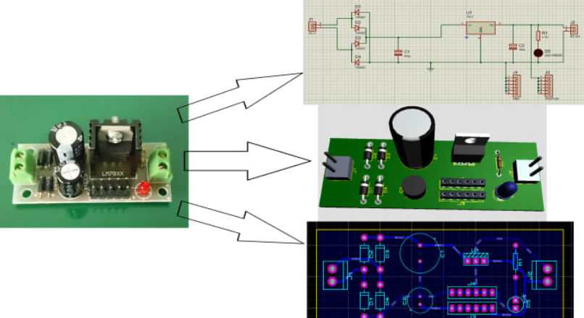
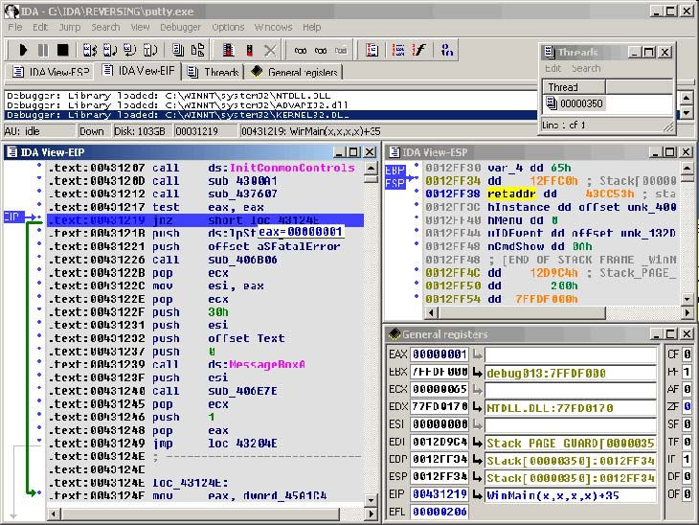
Reverse Engineering
Going from final product to some form of design documentation.
Datasheets???

Slide 4
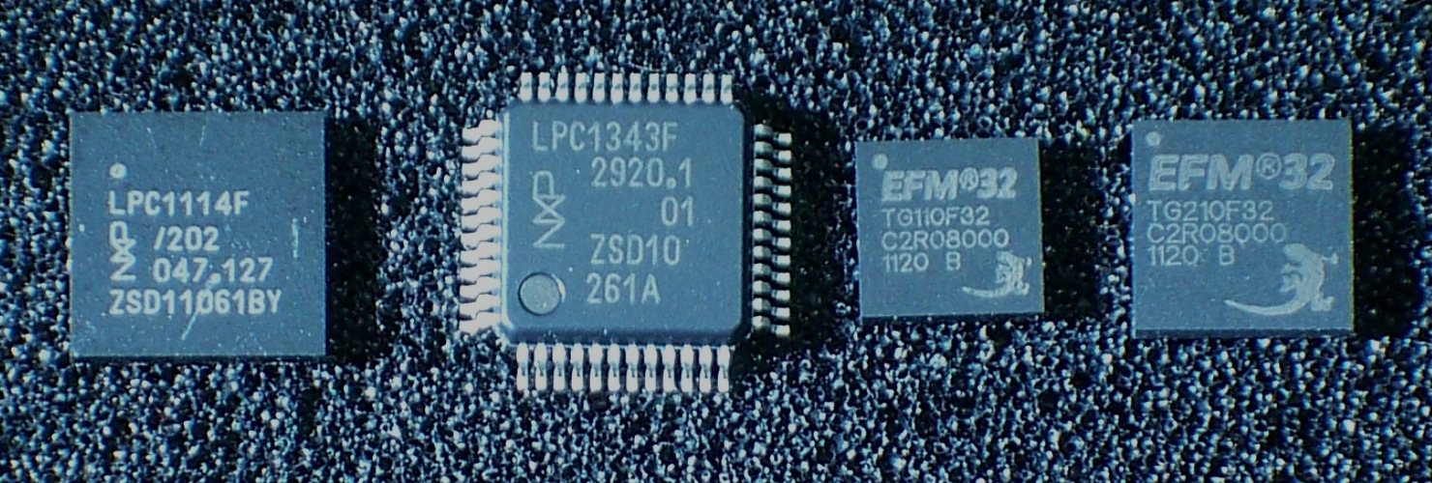
Software Reverse Engineering
Software reverse engineering is common requirement as part of security research.
We will focus in particular on Arm Cortex-m language reverse engineering.
https://en.wikipedia.org/wiki/ARM_Cortex-M#/media/File:ARM_Cortex-M0_and_M3_ICs_in_SMD_Packages.jpg

Slide 5
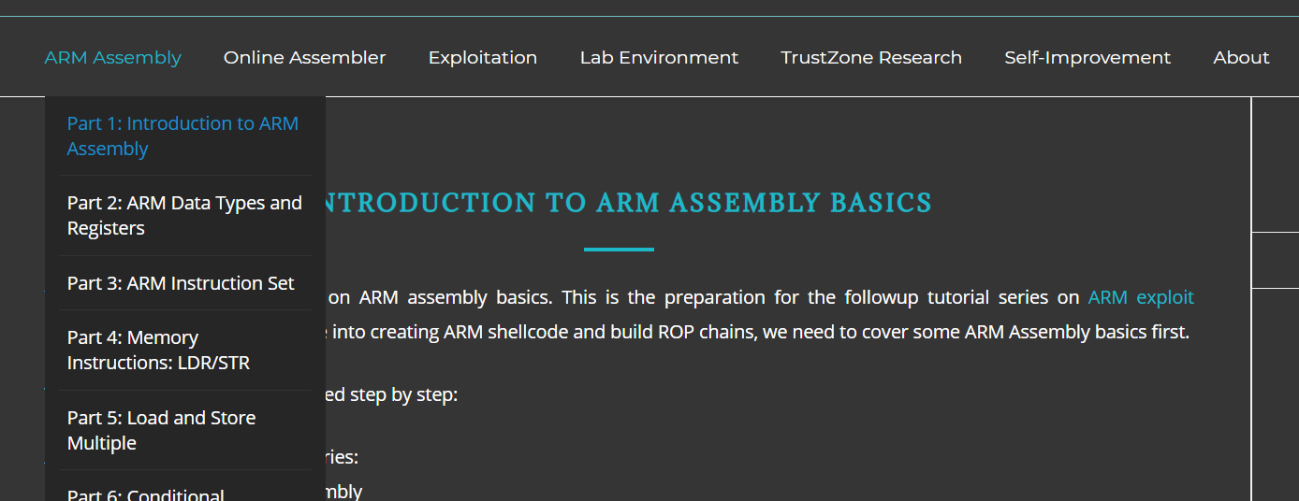
Resources for Arm Reverse Engineering
Recommended resource for more in depth - Azeria Labs -
https://azeria-labs.com/writing-arm-assembly-part-1/

Slide 6
What we are going to cover in this course:
What is reverse engineering (this quicky lecture).
Examples of C → Assembly
Exploring Function Calls
Looking at a few example binaries
…There is a *lot* more you can do with this ☺

